Slide 1
PearsonAccess Next Dashboards
Notes:
These training slides give an overview of the Dashboards feature in PearsonAccess Next.
Additional information is included in the Notes section of most slides.

Slide 2
Topics
Dashboard Introduction
Dashboard Roles
Accessing the Dashboards
Dashboard Home page
Dashboard User Settings
Notes:
We will cover the topics listed on this slide.

Slide 3
Dashboard Introduction
PAN Dashboards provide a visual display of information available elsewhere in PearsonAccess Next (PAN).
A Dashboard icon will be available on the top menu bar on all pages in PAN for users with the permissions described on the next slide.

Slide 4
Dashboard Roles
The following PAN user roles have dashboard access:
District Test Coordinator
School Test Coordinator
Technology Coordinator
Select the correct administration in the upper right-hand corner.
If you have access to multiple organizations in PAN, select the correct organization in the upper right-hand corner.

Slide 5
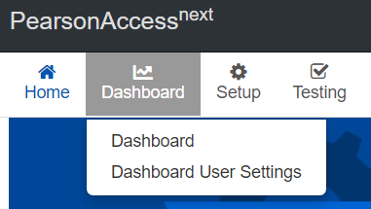
Accessing the Dashboards
To access the PAN Dashboard home page, select the Dashboard icon, and in the drop-down menu, select Dashboard.

Slide 6
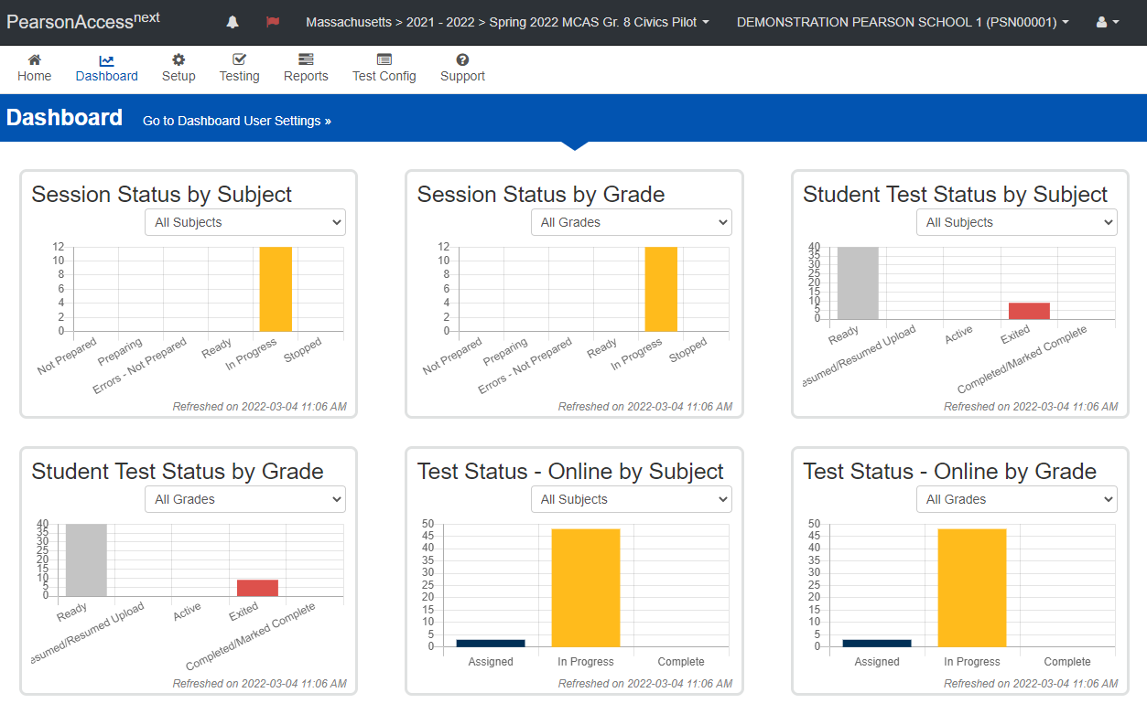
Dashboard Home Page
Here is a view of the Dashboard home screen.
Notes:
The Dashboard home page displays up to six different dashboards.

Slide 7
Dashboard Home
Dashboards can be viewed by subject or grade on the Dashboard home page as follows:
Session Status graph: Shows the number of PAN Sessions that are in each status: Not Prepared, Preparing, Errors – Not Prepared, Ready, In Progress, and Stopped.
Student Test Status graph: Shows the number of student tests that are in each status: Ready, Resumed/Resumed Upload, Active, Exited, and Complete/Marked Complete.
Test Status – Online graph: Shows the number of computer-based tests that are in each status: Assigned, in Progress, and Complete.

Slide 8
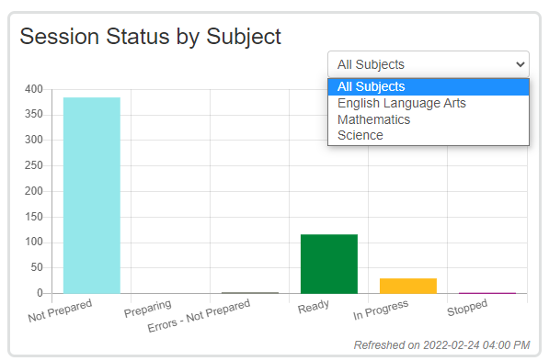
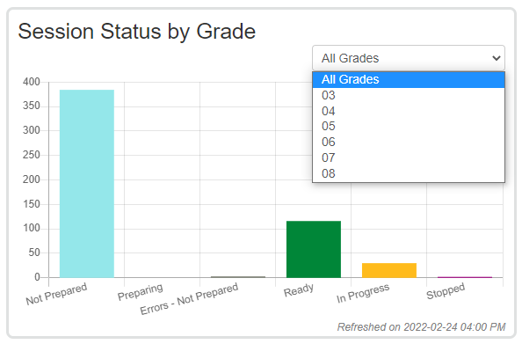
Dashboard Home Page – Session Status Dashboards
Session Status by Subject or Grade
Notes:
The Session Status dashboards show the number of PAN Sessions that are in each of the following statuses:
Not Prepared
Preparing
Errors – Not Prepared
Ready
In Progress
Stopped
Users can filter by subject or grade by selecting a subject or grade from the drop-down menus located on each dashboard. Test coordinators may want to use this graph to determine whether they have any Sessions that are not yet prepared on testing day, or if they have any Sessions that are not stopped at the end of testing. (All PAN Sessions must be stopped after testing has been completed.)

Slide 9
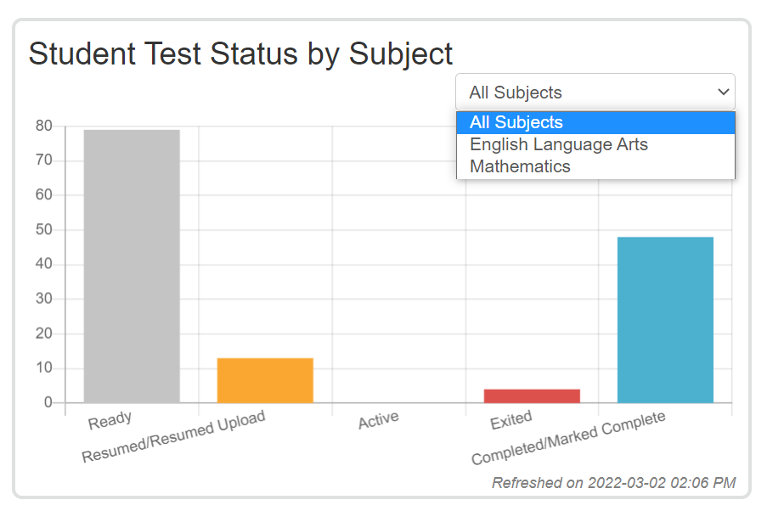
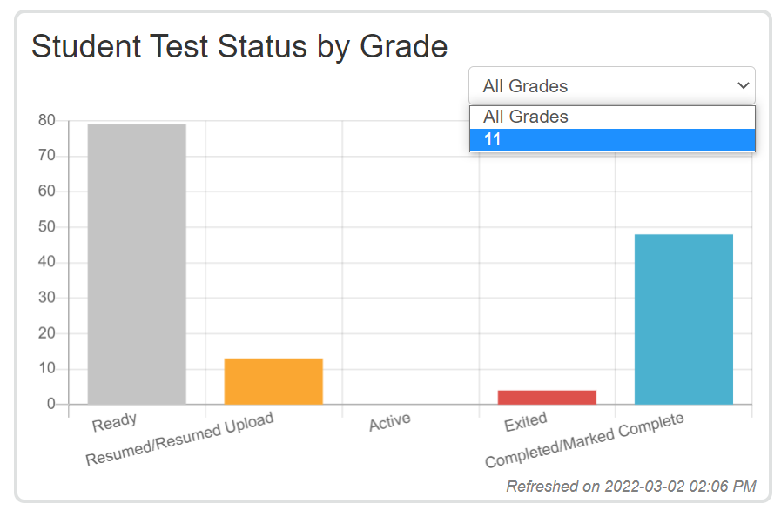
Dashboard Home Page – Student Test Status Dashboard
Student Test Status by Subject or Grade
Notes:
The Student Test Status dashboards show the number of student tests that are in each of the following statuses:
Ready
Resumed/Resumed Upload
Active
Exited
Completed/Marked Complete
Users can filter by subject or grade by selecting a subject or grade from the drop-down menus located on each dashboard. Test coordinators may want to use this dashboard to determine whether they have any student tests that are still in Active status at the end of a test session, or whether they have any student tests that are not in Complete or Marked Complete status at the end of testing.

Slide 10
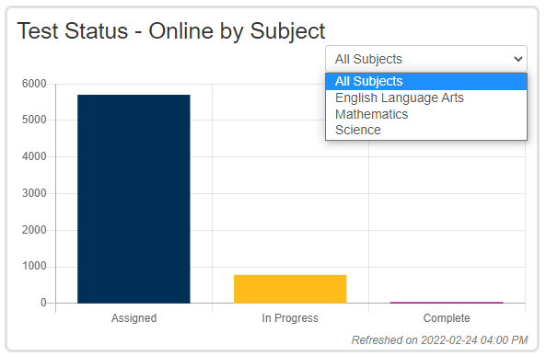
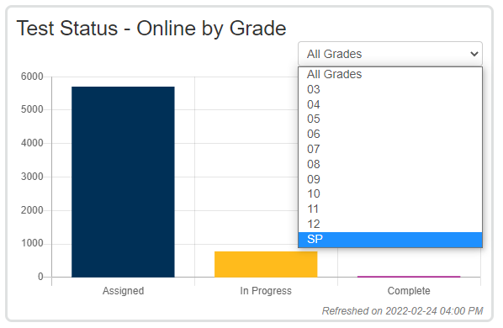
Dashboard Home Page – Test Status - Online
Test Status - Online by Subject or Grade
Notes:
The Test Status - Online dashboards show the number of computer-based tests in the following statuses:
Assigned
In Progress
Complete
Users can filter by subject or grade by selecting a subject or grade from the drop-down menus located on each dashboard. Test coordinators may want to use this dashboard to determine how many student tests in a subject or grade are not in Complete status.

Slide 11
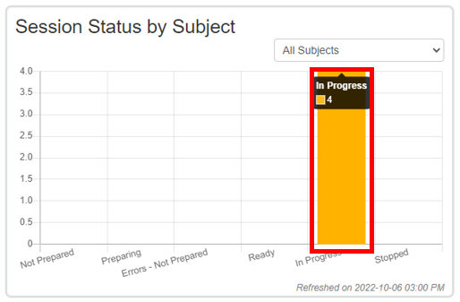
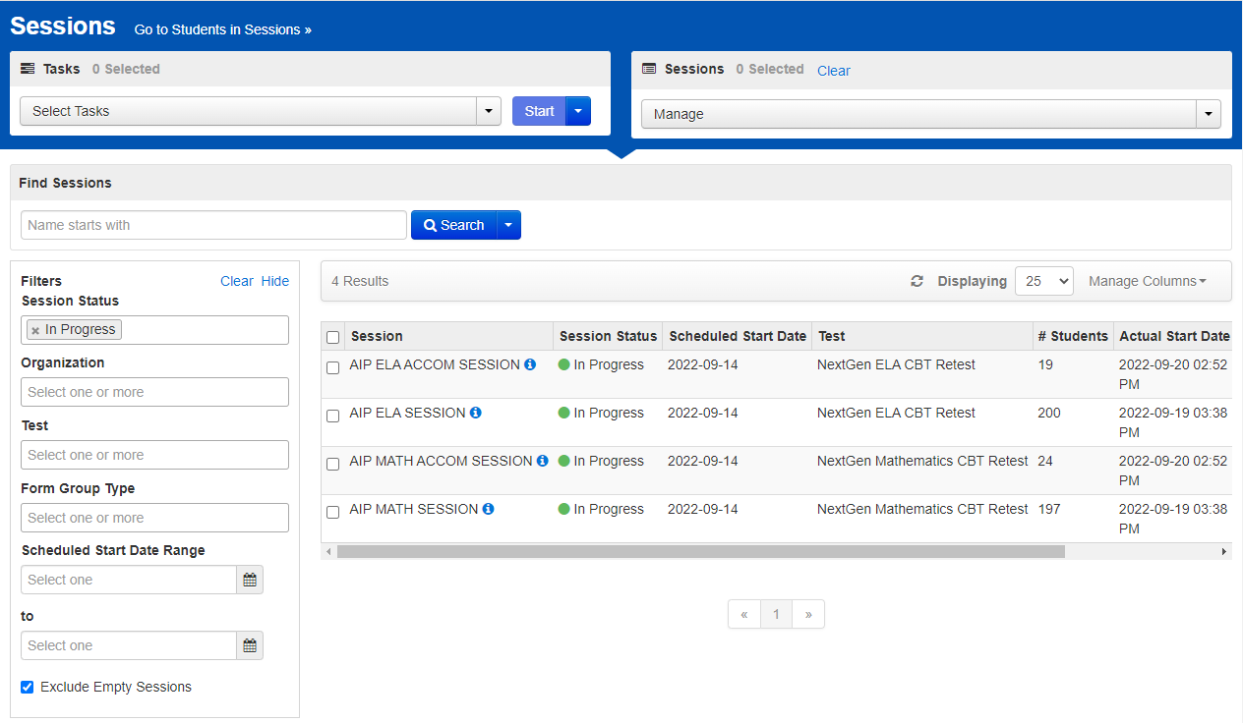
Dashboard Hyperlinks
Notes:
Some dashboards contain hyperlinks within the graphs to other pages in PAN. The dashboards that contain hyperlinks are:
Session Status by Subject – hyperlinks to the Sessions page
Student Test Status by Subject – hyperlinks to the Students in Sessions page
Test Status - Online by Subject – hyperlinks to the Student Tests page
When a user selects a particular status in each of these graphs, they will be taken to another page in PAN (listed above) that will display all of the Sessions or student tests that are in that status.
In the example shown on the slide, when a user selects the “In Progress” section of the Session Status by Subject graph, they will be taken to the Sessions page, which will display all of the Sessions that are in progress.

Slide 12
Dashboard User Settings
Users can adjust what they see on their Dashboard home page by changing the settings on the Dashboard User Settings page.
On the Dashboard User Settings page, users can:
Remove dashboards from their home page
Change the order in which the dashboards appear on their home page
Change the type of graph for each dashboard
Change the number of columns in which the dashboards appear
To access the Dashboard User Settings, select the Dashboard icon, and from the drop-down menu, select Dashboard User Settings.

Slide 13
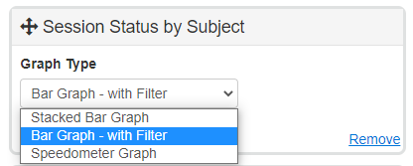
Dashboard User Settings—Change Order
Change the order in which dashboards appear by holding down the crossed arrows of a particular dashboard and moving the dashboard around the page.
Change the type of graph that is shown by selecting a graph from the drop-down menu.
Remove a dashboard from your home page by selecting “Remove.”

Slide 14
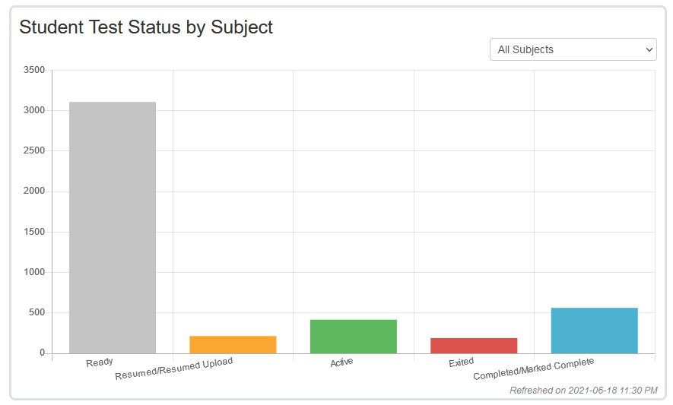
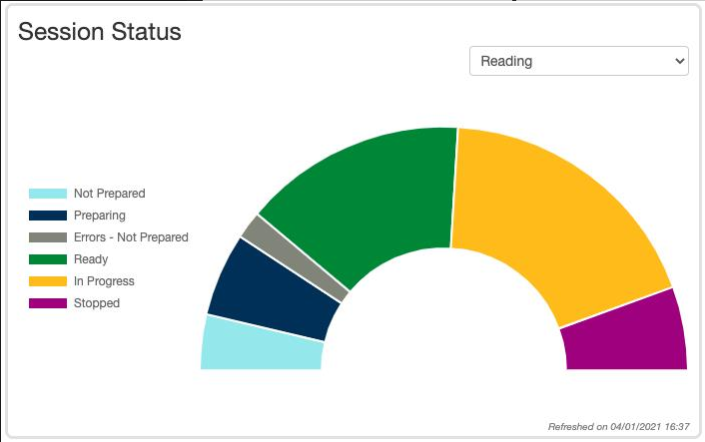
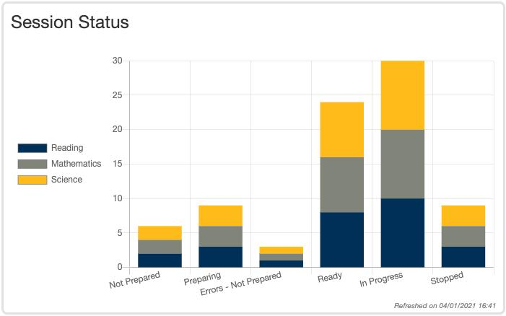
Dashboard User Settings—Graph Types
Bar graph with filter
Users can select from three graph types: bar, stacked bar, and speedometer. Note that for the following dashboards, not all graph types are available: Session Status by Grade, Student Test Status by Grade, and Test Status – Online by Grade.
Speedometer
Stacked bar graph

Slide 15
Dashboard User Settings—Columns
Change the number of columns that appear on your Dashboard home page by selecting from the Number of Columns drop-down menu.

Slide 16
Dashboard User Settings - Columns
Example of the home page with one column:
Example of the home page with three columns:

Slide 17
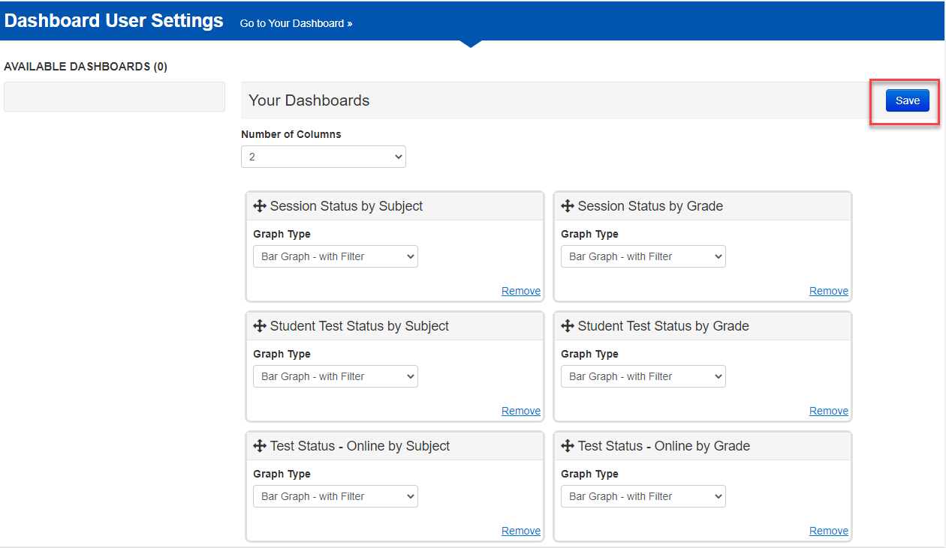
Saving Dashboard User Settings
After making the desired changes to your dashboards, select Save.

Slide 18
Thank you.
Thank you.

